Slide 1
Inexpensive Prosthetic Hand with EMG Control
Unique ID: SUP-021
Team Name: Tech NovaCorps

Slide 2
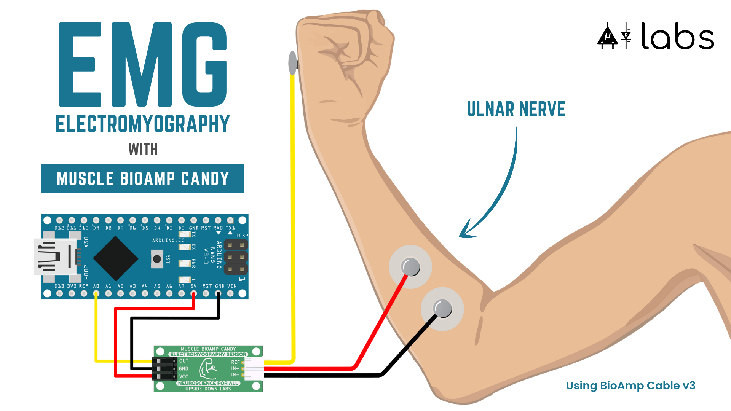
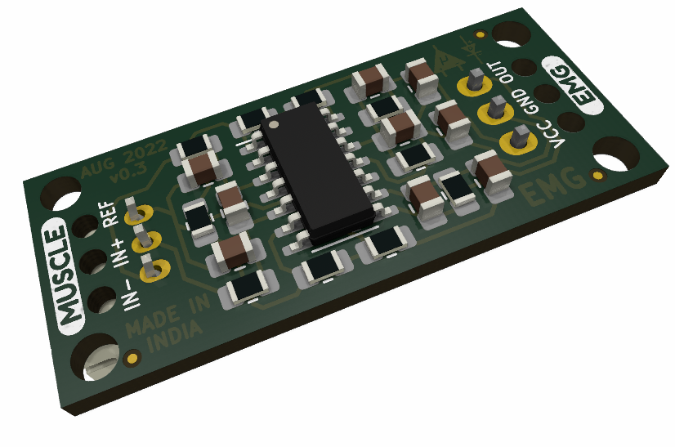
Introduction
Developing an Inexpensive Prosthetic Hand
EMG Signal Acquisition from Flexor Carpi Ulnaris Muscle (FCU) or Ulnar Nerve
Utilizing Muscle BioAmp Candy from Upside Down Labs

Slide 3
Technology Overview
Muscle BioAmp Candy
Compact EMG Sensor
Fixed Gain (x2420)
Bandpass Filter (72 – 720Hz)
Arduino Nano Microcontroller
Signal Processing
Servo Controlling Using PWM Signals

Slide 4
Components Used
Component Name | Price in Rupees
Muscle BioAmp Candy | 700
Arduino Nano Microcontroller | 250
3D Printed Prosthetic Hand Components | 1500
Servo Motors(5) | 510
Total | 2960
Muscle BioAmp Candy
Arduino Nano Microcontroller
3D Printed Prosthetic Hand
Servo Motors(5)
Overall System Cost Breakdown

Slide 5
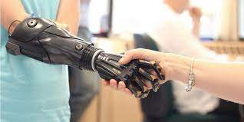
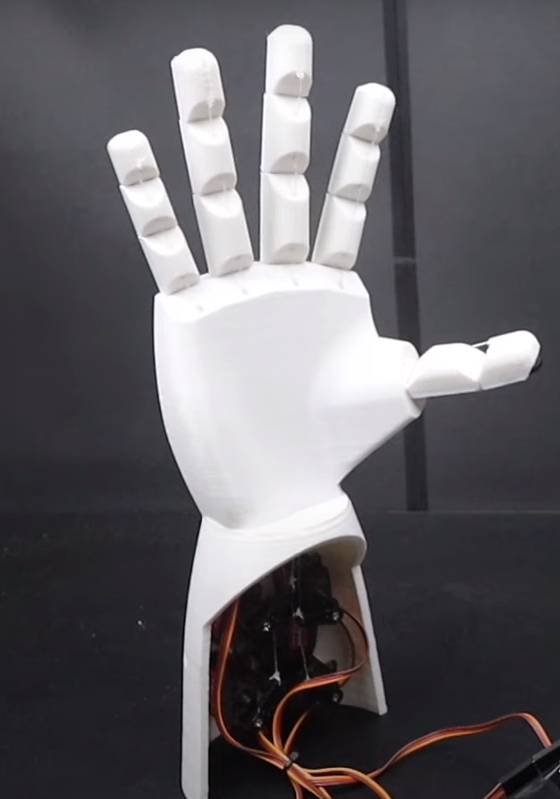
Cost Comparison
Market Alternatives Cost
Range: 5,000 USD to 8,000 USD
(415K-664K INR)
Project Cost
Total: 3,000 rupees or 37 USD
Emphasizing Cost-Effectiveness

Slide 6
What is EMG?
The EMG signal is generated by the electrical activity of the muscle fibers active during a contraction.
The signal sources are the depolarizing and repolarizing zones of the muscle fibers.

Slide 7
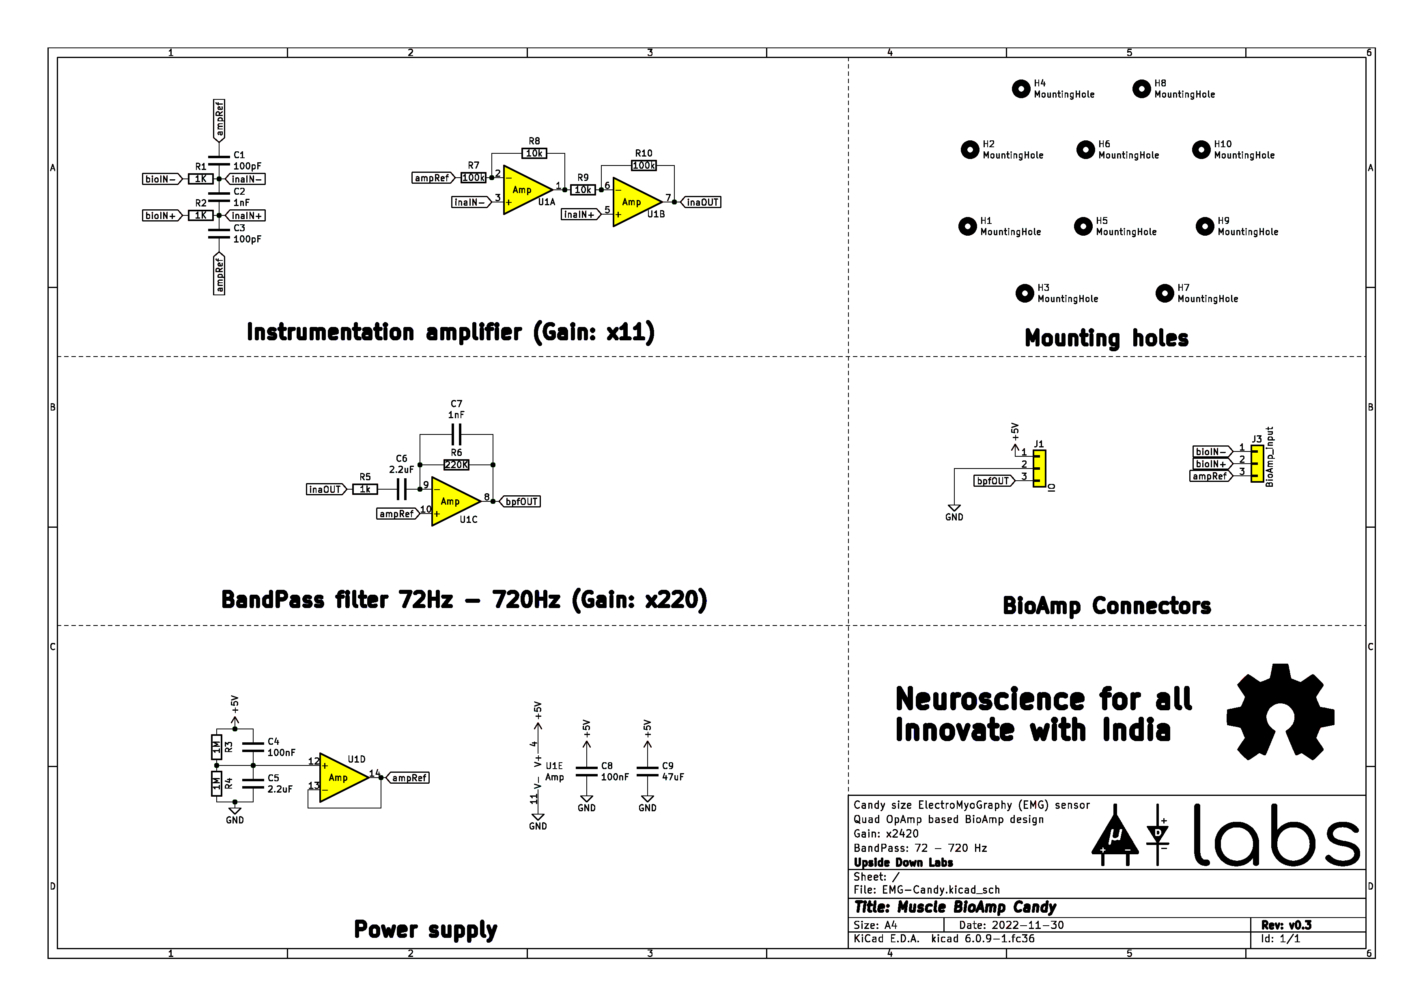
Muscle BioAmp Candy
Band-Pass Butterworth IIR digital filter(72-720Hz)
Sampling rate: 500.0 Hz,
Filter is order 4, implemented as second-order sections (biquads).

Slide 8
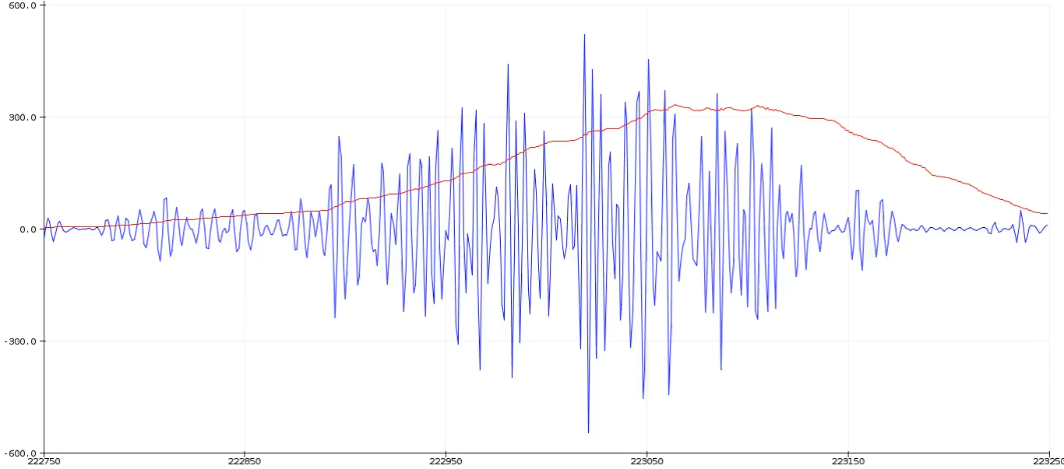
Signal Processing
Role of Muscle BioAmp Candy
Instrumentation Amplifier
Non Inverting Amplifier
Bandpass Filter (72 – 720Hz)
Role of Arduino Nano
Works as ADC for converting the
analog signals to digital signals
Envelope Detection

Slide 9
Conclusion
Economic Viability and Affordability
Bridging the Gap in Prosthetic Technology
Future Potential and Development

Slide 10
References
https://docs.scipy.org/doc/scipy/reference/generated/scipy.signal.butter.html
https://courses.ideate.cmu.edu/16-223/f2020/Arduino/FilterDemos/filter_gen.py
https://github.com/upsidedownlabs

Slide 11
Team Members
Rajdeep Saha (Electronics and Communication Engineering)
Abhijit Biswas (Electronics and Communication Engineering)
Saradwat Sen (Electronics and Communication Engineering)
Sayani Dhali (Electronics and Communication Engineering)

